Slide 1
Multiclass Classification of Bangla Cyber Bullying Using Bi-LSTM and BanglaBERT
Presented By
Supervised By
Co-Supervised By
Name: Md. Asaduzzaman ID: M-200305019
Dr. Ujjal Kumar Acharjee
Professor
Department of Computer Science & Engineering
Jagannath University
Dr. Md. Manowarul Islam Associate Professor
Department of Computer Science & Engineering
Jagannath University

Slide 2
OUTLINE
Introduction
Motivation
Objective
Related Works
Methodology
Experiments and Results
Conclusion & Future Work

Slide 3
Introduction
What is Cyberbullying?
Cyberbullying refers to the use of digital technologies to intentionally and repeatedly harm, harass, or intimidate an individual or group. This can occur through various online platforms such as social media, messaging apps, forums, and other digital communication tools
Growing Concern
Why Automated Detection?
Increase in the use of social media and online communication has led to a rise in cyber bullying cases.
Cyber bullying can occur anonymously, making it more prevalent and difficult to control.
Manual monitoring is not scalable due to the large volume of online interactions
Automated systems can provide real-time detection and intervention, potentially preventing harmful effects.

Slide 4
Cyberbully Scenario in Bangladesh
Almost 49% of students have reported being victims of cyberbullying
A study has concluded that 50% of Bangladeshi teenagers had been victims of cyberbullying until 2018.
The study also indicates that 61% of the in Bangladesh send explicit messages online, which is known as “sexting.”
Around 40% of students expressed positive opinions about consulting with their parents.
32% kids at risk of cyberbullying in Bangladesh: UNICEF
80% of cyberbullying victims are women

Slide 5
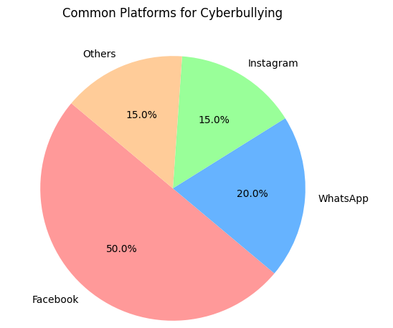
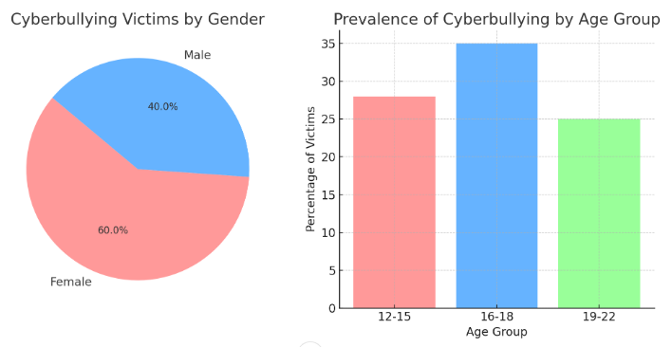
Statistical View of Bangla Cyberbullying

Slide 6
Motivation
Cyberbullying is a pervasive issue in today's digital age, affecting millions of individuals worldwide, including a significant number of people in Bangladesh. With the rapid expansion of internet access and the widespread use of social media platforms, the incidence of cyberbullying has increased, leading to severe psychological, emotional, and social consequences for victims. This underscores the urgent need for effective detection and intervention strategies to combat cyberbullying.
Prevalence of Cyberbullying
Challenges in Manual Detection
High percentage of teenagers in Bangladesh experiencing cyberbullying
Significant impact on mental health, particularly among females
Impractical of manual monitoring due to high volume of online interactions
Need for scalable, automated detection system

Slide 7
Future Vision
Advancement of NLP and ML
Impact of Accurate Detection
Utilization of NLP and Machine Learning for advanced text classification.
Enhanced detection capabilities by capturing contextual nuances in Bangla text
Crucial for implementing effective intervention strategies.
Ability to distinguish between various types of cyberbullying for tailored responses
Contributing to Safer Digital Spaces
Promotes positive and respectful online interactions
Provide a language specific solutions in digital spaces
Benefits the overall digital ecosystem in Bangladesh

Slide 8
Objectives
Dataset Collection
Data Preprocessing
Model Selection and training
Performance Evaluation
Result analysis

Slide 9
Related Work
Author’s Name | Working Principal | Used Algorithms | Classification Accuracy | Year
A.Desai, S.Kalaskar, O. Kumbhar and R. Dhumai | Binary Classification of cyberbullying using ML model and BERT and a comparative study | ML model(NB, SVM) and BERT | 91.90% | 2021
T.Sultan, N.Jahan and R.Basak | Binary classification of bangla social media comment from both online available data and using OCR. TF-IDF and BoW used as features | Traditional ML models with boosting | 96% | 2023
N.Yuvaraj, V.Chang, B.Gobinathan and A.Pinagapani | Automatic cyberbully detection from tweets. This approach used combination of various feature selection process like Information gain, Chi-square, and Pearson Correlation | Linear an non linear deep Decision Tree based algorithm along with DNN and ANN | 99% | 2022

Slide 10
Related Work
Author’s Name | Working Principal | Used Algorithms | Classification Accuracy | Year
R. Haque, N. Islam, M. Tasneem and A.K.Das | Multi-class(4 Class) sentiment analysis using NLP and text mining for Bengali Facebook comments . | Number of DL & ML Model. Proposed CLSTM model | 85.8% | 2023
S. Saha, S. Islam, M. Alam and Z.H.Majumder | Multiclass (5 class) bangla cyberbully detection using ML model & DL model | Naïve Bayes, Random Forest, SVM, XGB & BanglaBERT Base | 90% | 2023
K.Poojitha, A.S.Charish, M.A.Kumar | Binary classification of social media toxic comment from social media comments. TF-IDF and BoW features were used and data sampling was performed. | Traditional ML models and LSTM, CNN, LSTM+CNN(proposed) | 97.7 | 2023

Slide 11
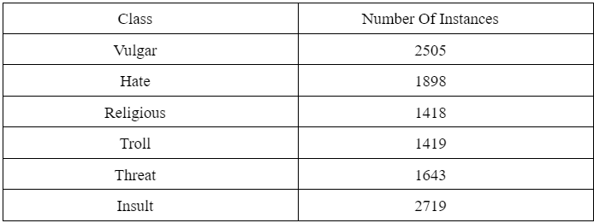
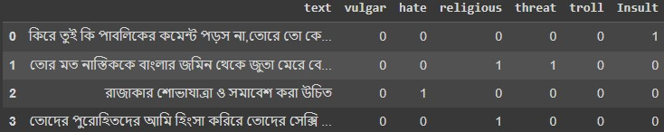
Methodology
Dataset
We worked on Bangla Social media comment dataset from Kaggle. The dataset contains Bangla comments from different social media platform. The dataset is classified into 6 different class.

Slide 12
Data Preprocessing
Data Cleaning
Remove Stop word and emoji
Remove URLs non-word and whitespaces
Stemming

Slide 13
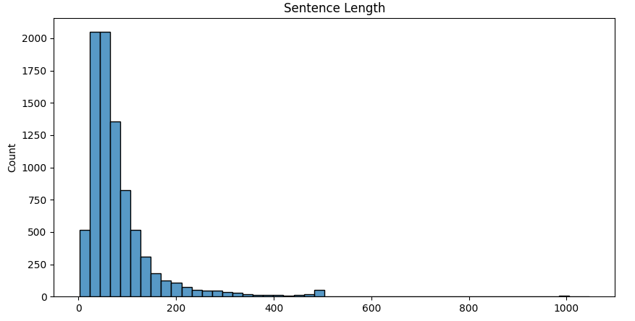
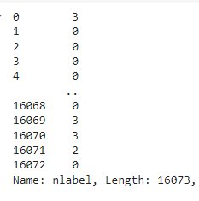
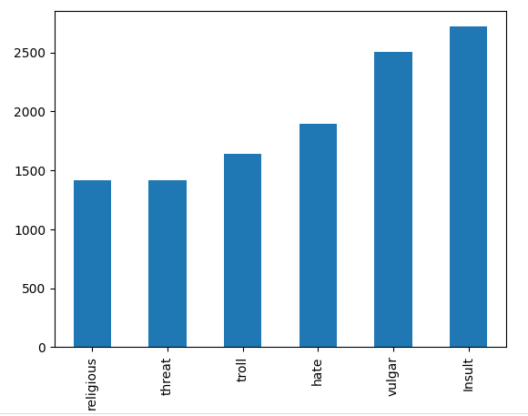
Data Preprocessing

Slide 14
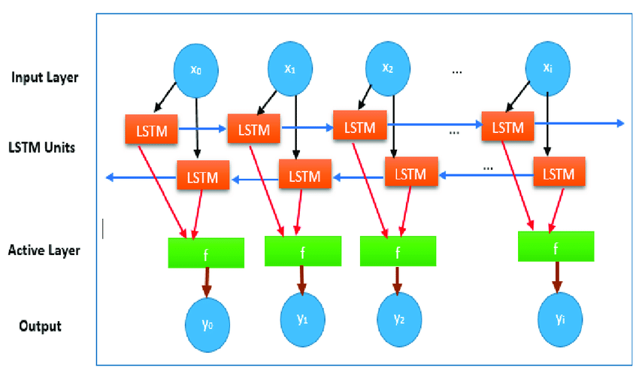
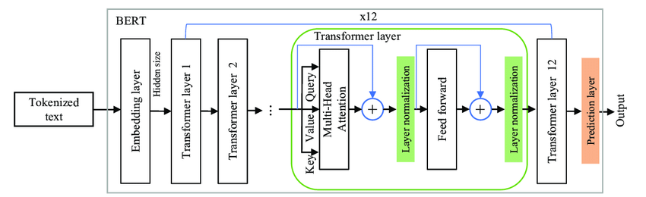
Proposed Model
Bangla-BERT
Bi-LSTM

Slide 15
Model Training
Total Data | Training | Testing | Validation
16073 | 5093 | 1368 | 2065
Class | Count(training)
Vulgar | 1503
Hate | 1139
Religious | 851
Threat | 851
Troll | 986
Insult | 1631

Slide 16
Model Hyperparameters
Name | Value
Optimizer | Adam
Loss function | Binary Cross-entropy
Metrices | Accuracy
Batch Size | 16
Max Length | 300
Activation Function | Sigmoid

Slide 17
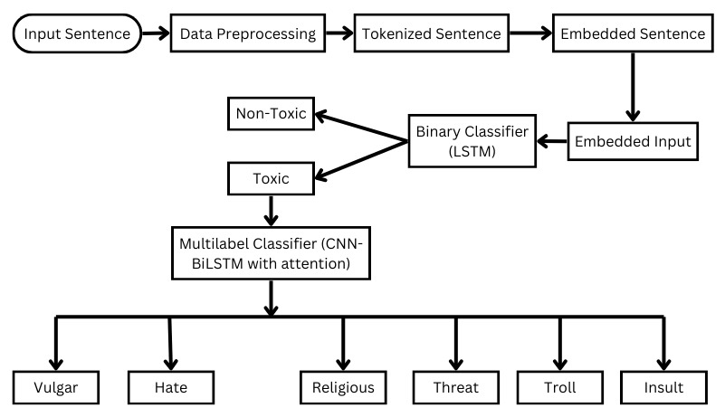
Workflow Diagram

Slide 18
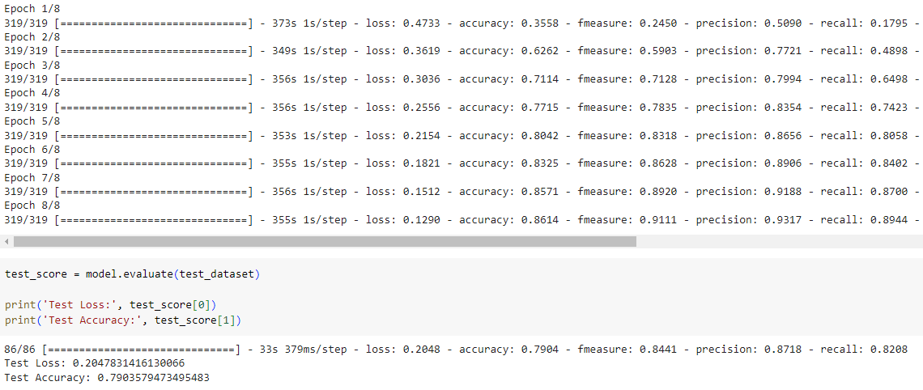
Model Performance

Slide 19
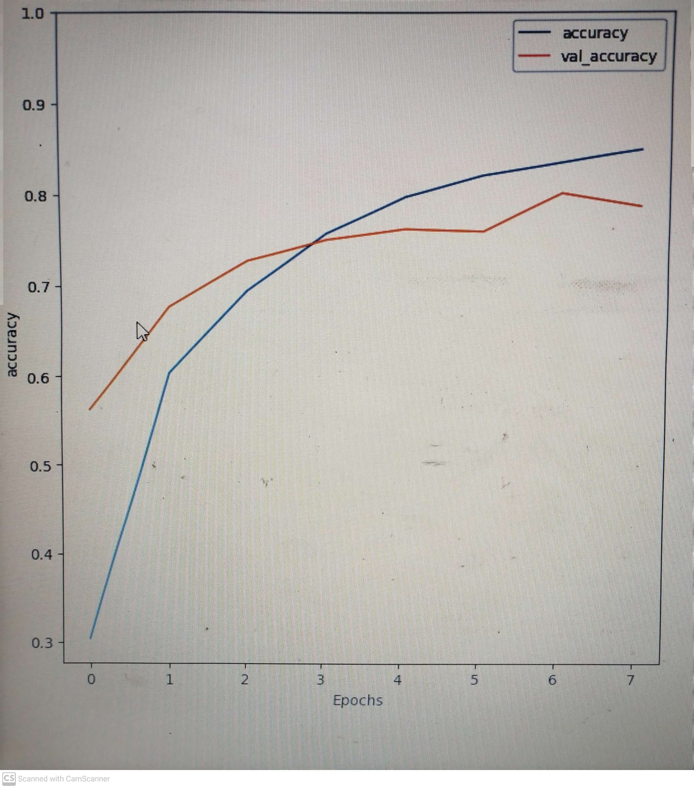
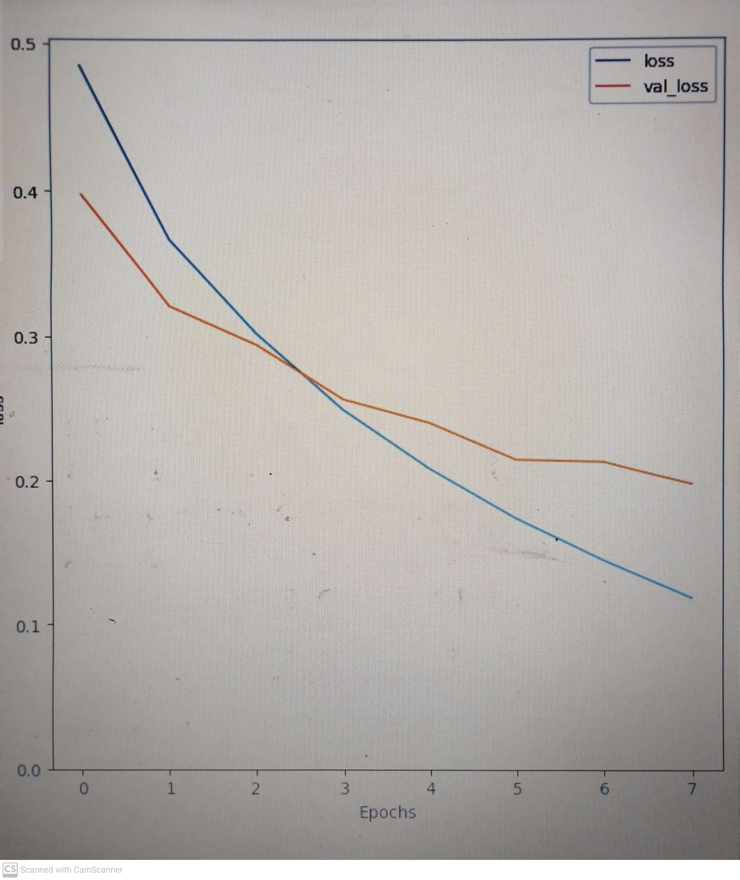
Model Performance

Slide 20
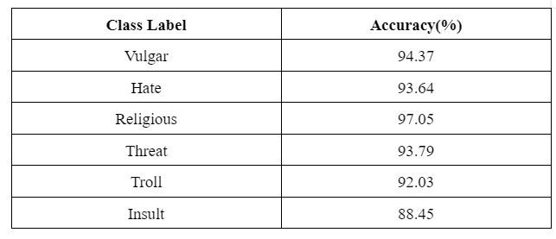
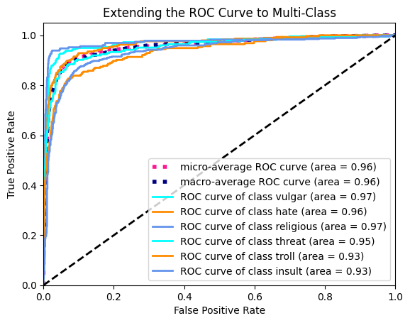
Accuracy

Slide 21
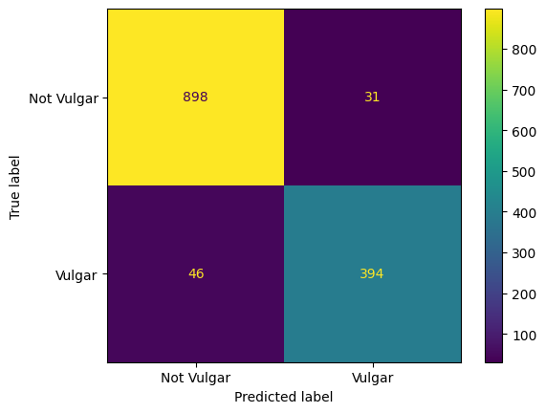
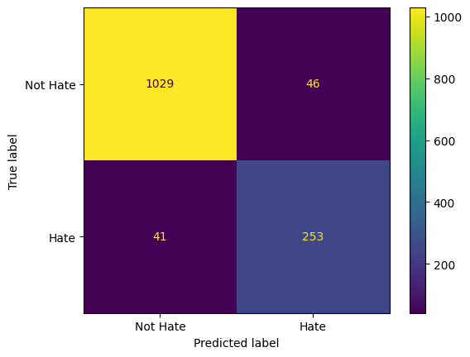
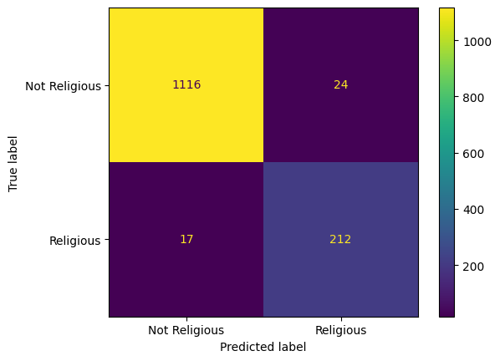
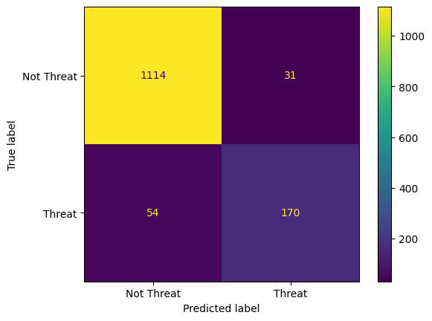
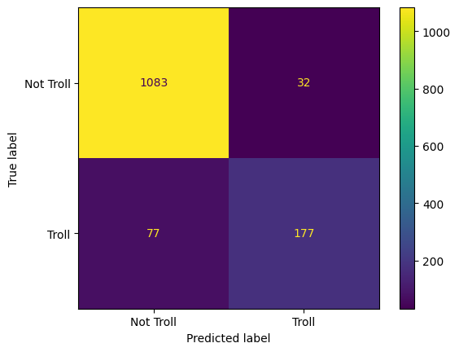
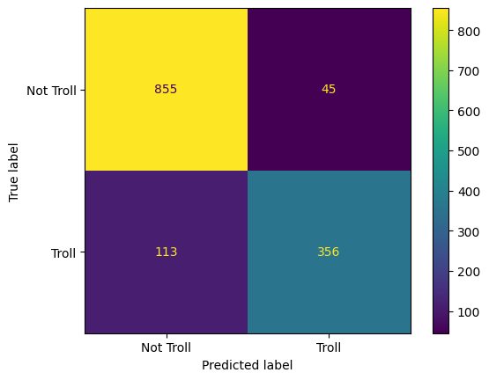
Confusion Matrix

Slide 22
Conclusion
Integrated Approach: Combining CNN, Bi-LSTM and Bangla BERT shows significant promise in detecting various forms of cyberbullying in Bangla text
Improved Accuracy: Initial results demonstrate enhanced accuracy and robustness compared to traditional methods.
Comprehensive Solution: This approach leverages powerful contextual embeddings and captures both local and long-term dependencies effectively.
Continued advancement in data, model architectures, and ethical considerations are crucial
Collaborative efforts can drive the development of robust, real-world solutions

Slide 23
Future Scope
Model Improvement
Hybrid Model Exploration
Attention Mechanisms
Transfer Learning
Data Enhancement
Expansion of dataset
Annotated Data
Optimization Techniques
Hyperparameter Tuning
Regularization Methods
Hardware Utilization
Multilingual & Cross-Lingual Approach
Multilingual Training
Language Agnostic Models
Local Language Translation

Slide 24
References
Bangladesh Telecommunication Regulatory Commission. Available online: http://www.btrc.gov.bd/site/page/347df7fe-409f-451e-a415-65b109a207f5/- (accessed on 15 January 2023).
Mahmud, T.; Ptaszynski, M.; Eronen, J.; Masui, F. Cyberbullying detection for low-resource languages and dialects: Review of the state of the art. Inf. Process. Manag. 2023, 60, 103454.
Mahmud, T.; Ptaszynski, M.; Masui, F. Automatic Vulgar Word Extraction Method with Application to Vulgar Remark Detection in Chittagonian Dialect of Bangla. Appl. Sci. 2023, 13, 11875.
Pawar, R.; Raje, R.R. Multilingual cyberbullying detection system. In Proceedings of the 2019 IEEE international conference on electro information technology (EIT), Brookings, SD, USA, 20–22 May 2019; IEEE: Piscataway, NJ, USA, 2019; pp. 040–044.
Haidar, B.; Chamoun, M.; Serhrouchni, A. Multilingual cyberbullying detection system: Detecting cyberbullying in Arabic content. In Proceedings of the 2017 1st cyber security in networking conference (CSNet), Rio de Janeiro, Brazil, 18–20 October 2017; IEEE: Piscataway, NJ, USA, 2017; pp. 1–8.

Slide 25
References
6. Okoloegbo, C.A.; Eze, U.F.; Chukwudebe, G.A.; Nwokonkwo, O.C. Multilingual Cyberbullying Detector (CD) Application for Nigerian Pidgin and Igbo Language Corpus. In Proceedings of the 2022 5th Information Technology for Education and Development (ITED), Abuja, Nigeria, 1–3 November 2022; IEEE: Piscataway, NJ, USA, 2022; pp. 1–6.
7. Mahajan, E.; Mahajan, H.; Kumar, S. EnsMulHateCyb: Multilingual hate speech and cyberbully detection in online social media. Expert Syst. Appl. 2023, 236, 121228.
8. Si, S.; Datta, A.; Banerjee, S.; Naskar, S.K. Aggression detection on multilingual social media text. In Proceedings of the 2019 10th International Conference on Computing, Communication and Networking Technologies (ICCCNT), Kanpur, India, 6–8 July 2019; IEEE: Piscataway, NJ, USA, 2019; pp. 1–5.
9. Roy, S.G.; Narayan, U.; Raha, T.; Abid, Z.; Varma, V. Leveraging multilingual transformers for hate speech detection. arXiv 2021, arXiv:2101.03207.
10. El-Alami, F.z.; El Alaoui, S.O.; Nahnahi, N.E. A multilingual offensive language detection method based on transfer learning from transformer fine-tuning model. J. King Saud Univ.- Comput. Inf. Sci. 2022, 34, 6048–6056.

Slide 26
Thank You!!!

